Slide 1

BANK ANALYTICS
PROJECT
BY HARIOM CHAUDHARY

Slide 2
INTRODUCTION
The Bank Analytics Project is about analyzing Banking Loan Data and find trends and patterns which enable banks to make informed decisions. The data driven decision in banking empower stakeholders to optimize the strategies and detect fraudulent activities.

Slide 3
OBJECTIVES
It helps to understand-
Loan performance
Lending capacity of banks
Risk assessment
Consumer spending behaviour
Borrowing ability
Market trends etc.

Slide 4
Our Analytical Framework: Data and Methods
Analysed Banking Data having customer details, sanctioned loan amount, recovery details, interest earned, delinquent loans and NPAs.
Tools used-
SQL to fetch data from the databases.
Power query editor to transform the data.
Excel to analyse the initial patterns and identify the key performance indicators.
Power BI and Tableau for visualizing and dashboarding.

Slide 5
KEY PERFORMANCE INDICATORS
Total loans sanctioned
Total funded amount
Total collection
Total revenue
Total interest recovered

Slide 6

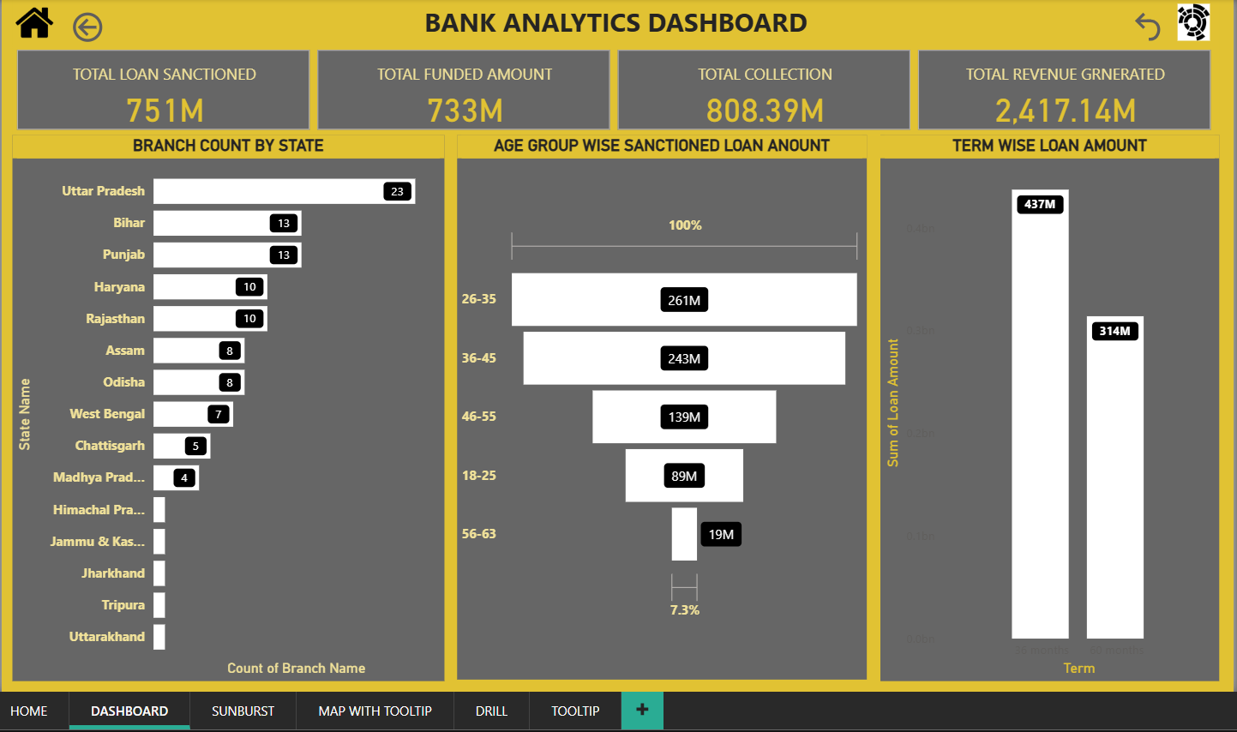

Features-
KPIs
Bar graph: State wise number of Branches
Funnel chart: Age group wise Loans Sanctioned
Column chart: Term wise Loan Amount
Page navigation
Drill down
Dax

Slide 7
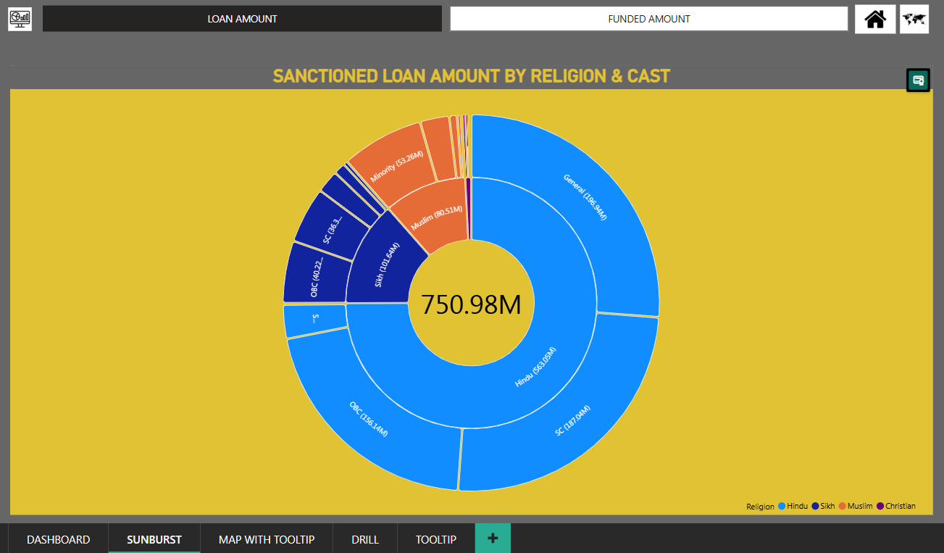
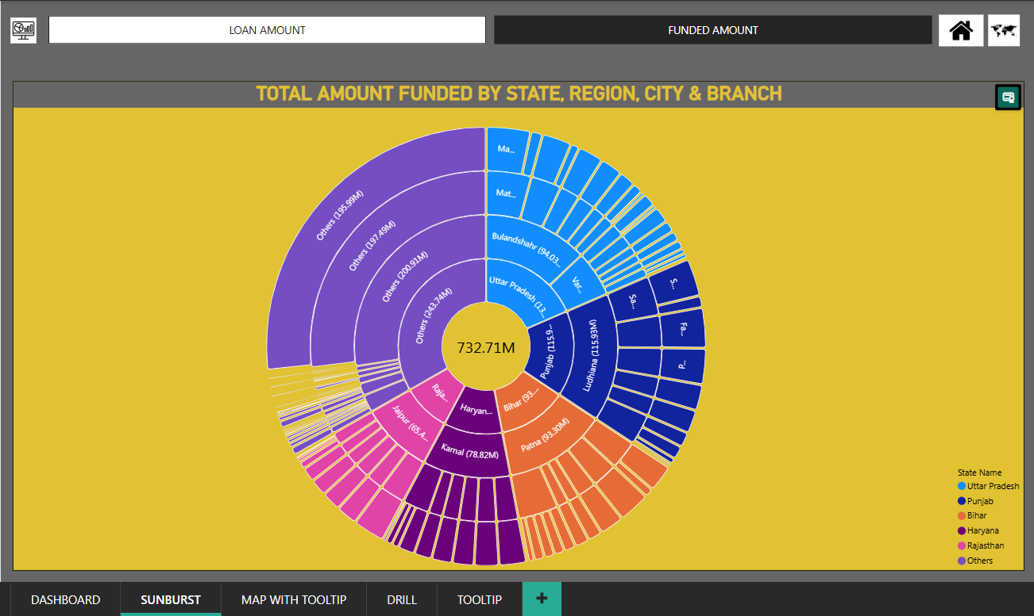
Features-
Sunburst (custom chart)
Bookmark
Page navigation

Slide 8
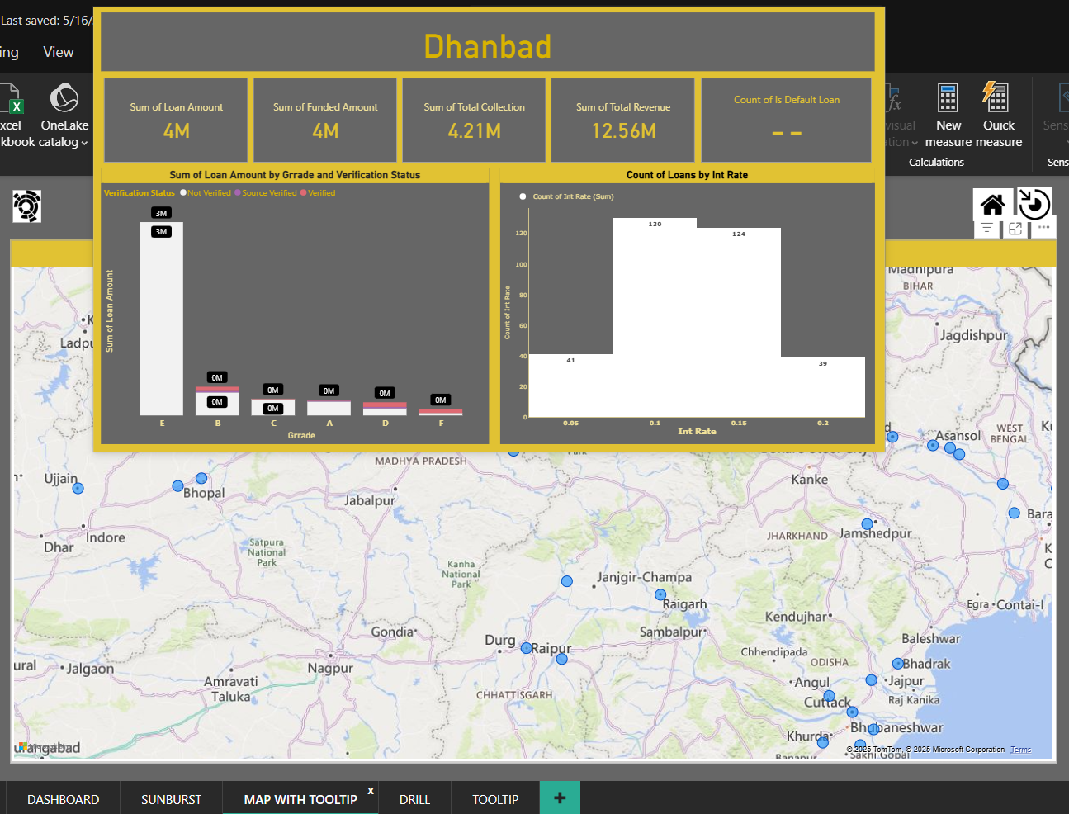
Features-
Map visual
Advance tooltip
Page navigation

Slide 9
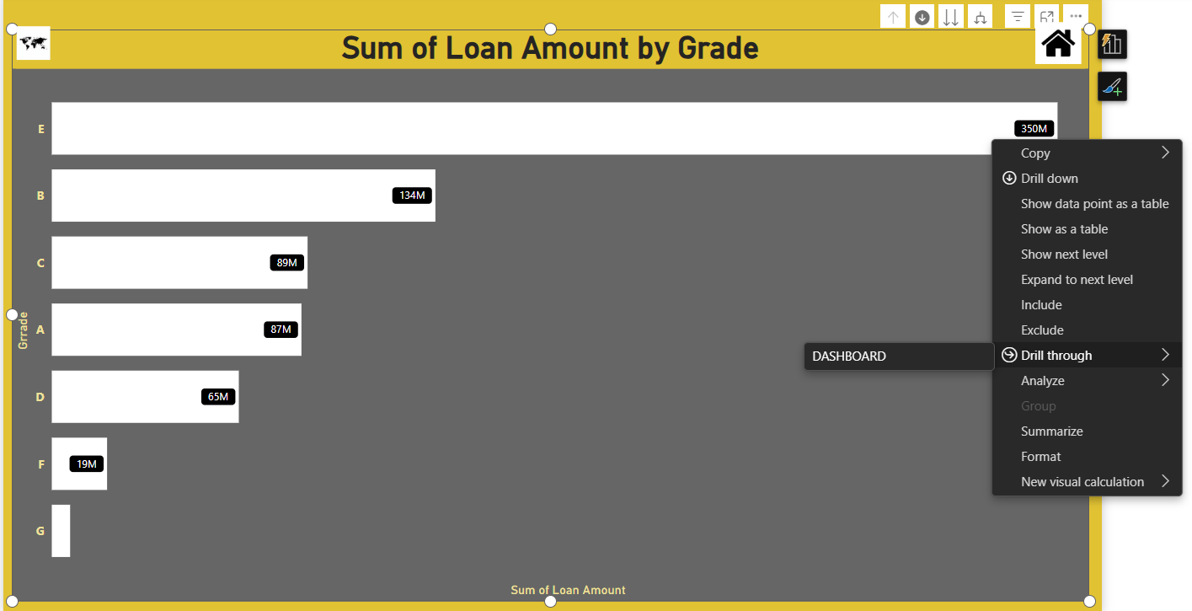
Features-
Bar graph
Drill down
Drill through
Page navigation

Slide 10

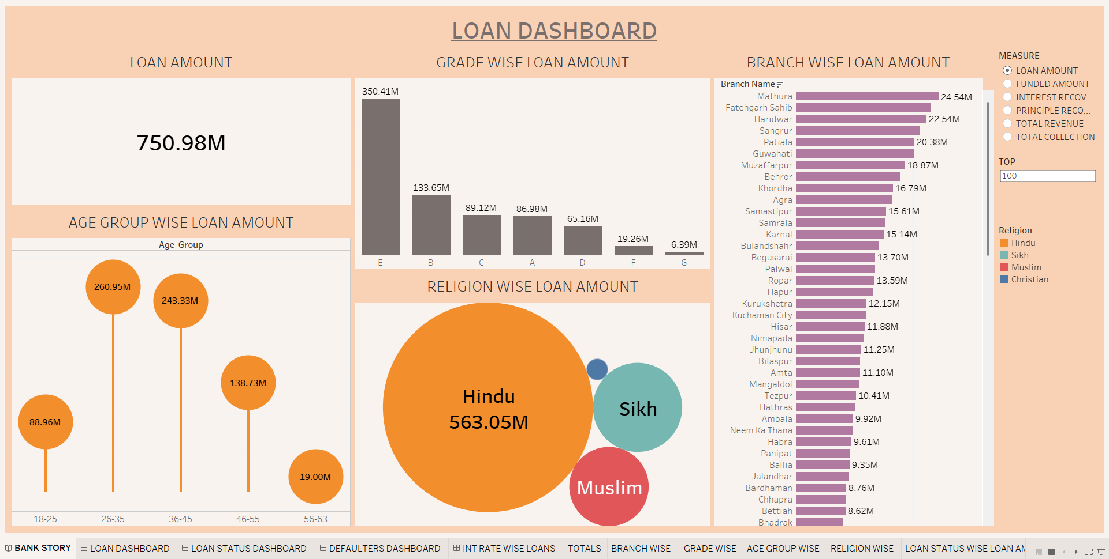
Features-
Bar graph
Packed bubbles
Column chart
Lollypop chart
Parameters
Calculated field

Slide 11
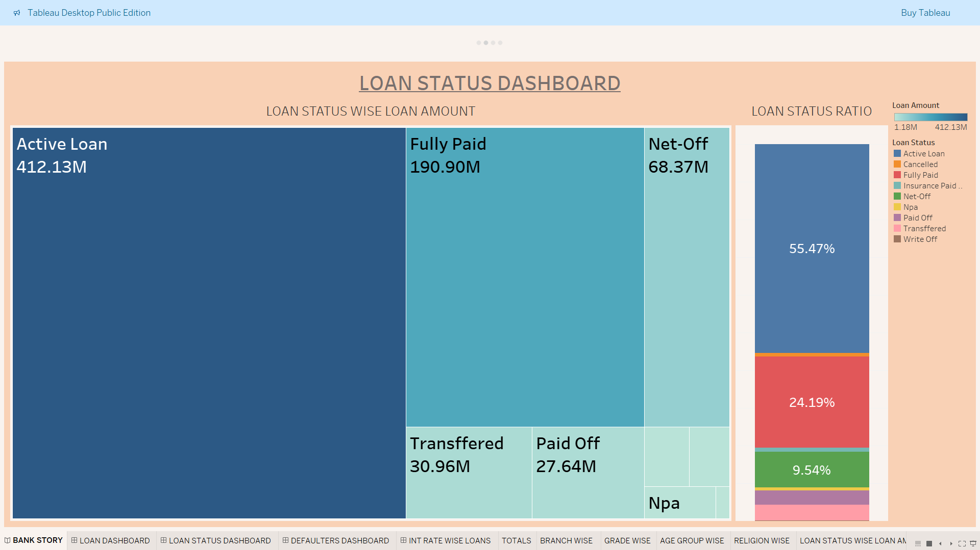
Features-
Tree map
Stacked Bar chart

Slide 12
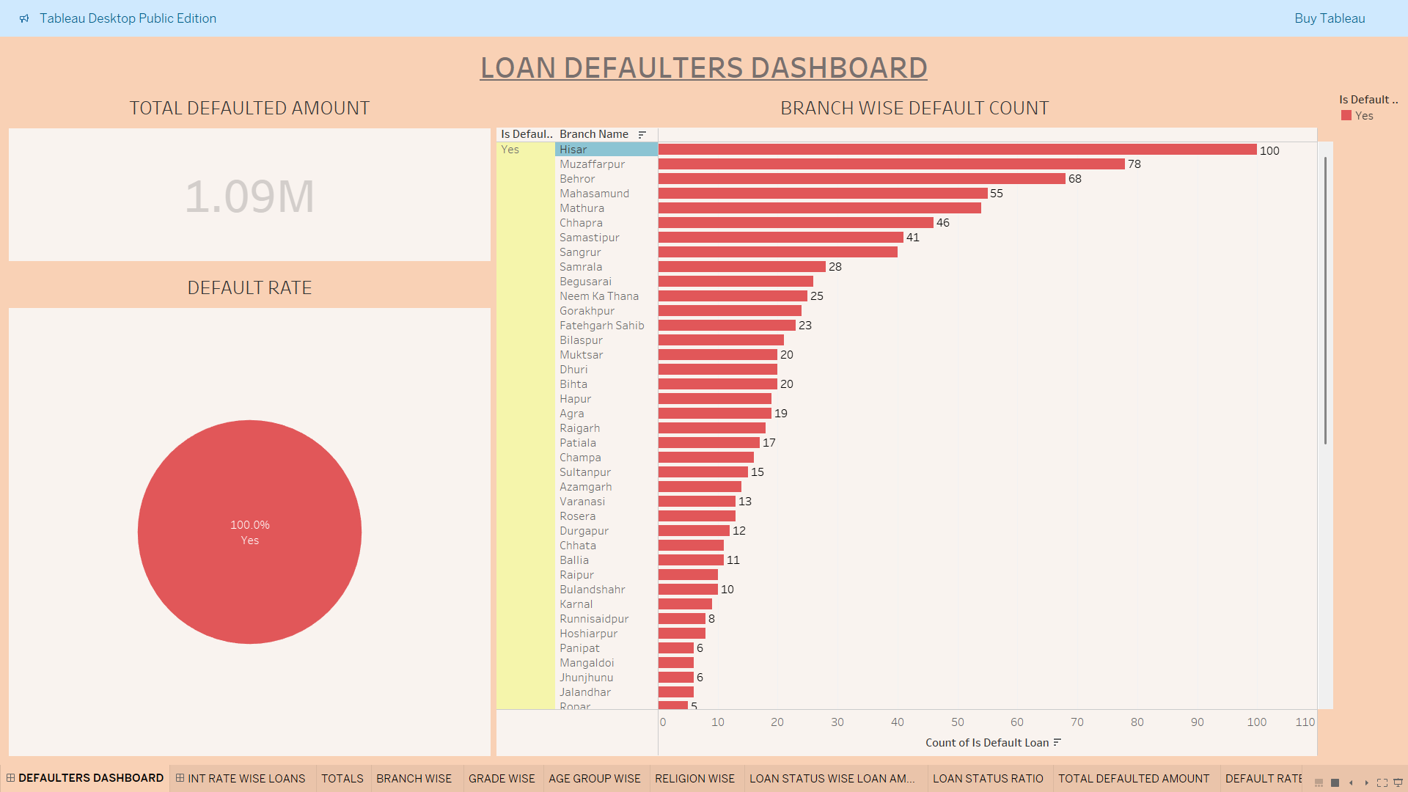
Features-
Pie chart
Bar chart
KPI
Dimension filter
Measure filter

Slide 13
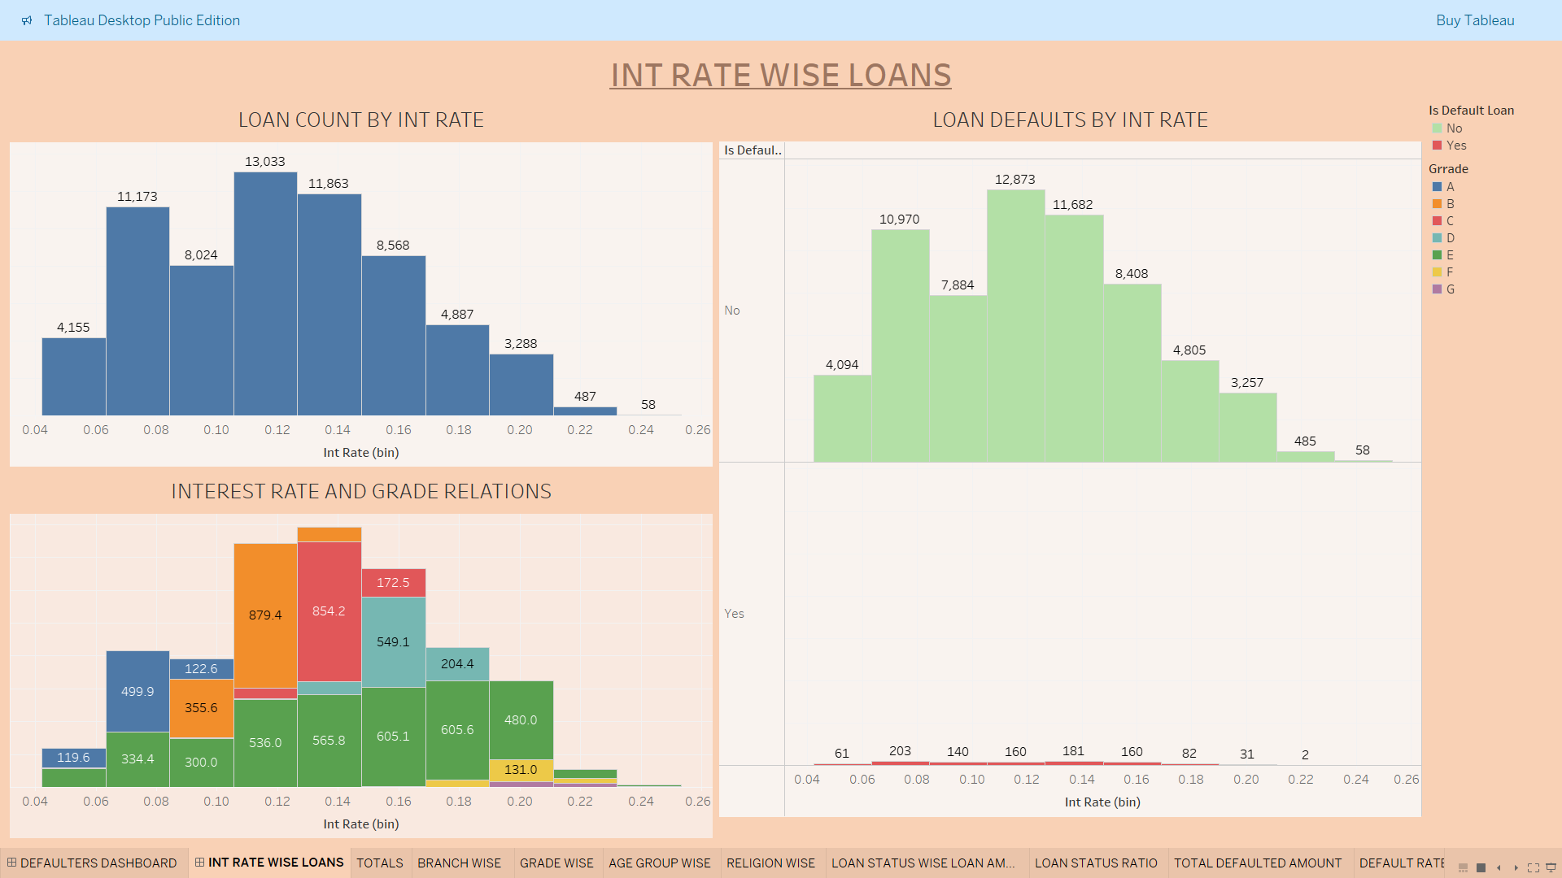
Features-
Histogram

Slide 14

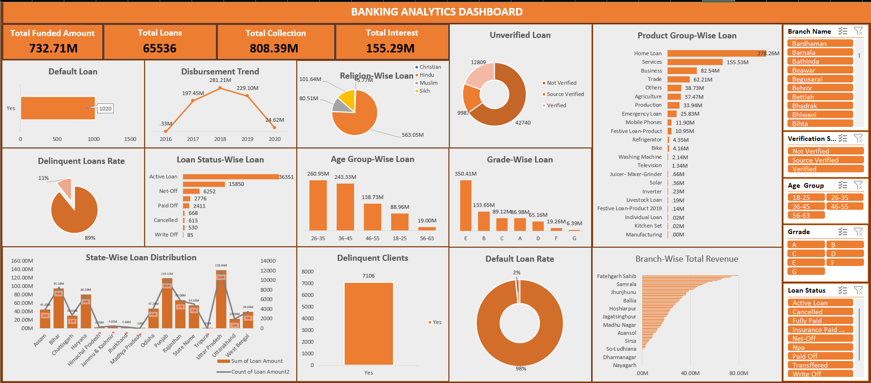
Features-
1. Pivot table 2. Power query 3. Charts 4. KPIs

Slide 15
INSIGHTS
The highest amount of loan is given to the people belonging to the age group of 26-35. The probable reason being the young earning class. This is a good sign.
'E' grade loan amount being the highest of all grades questions the loan distributing criteria.
Default rate is 1.56% which amounts to 11.24M.
Hisar, Muzaffarpur, Behror are the branches which are having most number of default loans.
'E' grade loans are given on the interest rates as low as 4%-8% which is again questioning the lending criteria.
Approx. 11% loans are delinquent.
Approx. 65% loans are not verified which is not a good lending practice and are prone to default.
The maximum loan amount is sanctioned for home loans.
ST caste is having the least share in loans sanctioned.

Slide 16
RECOMMENDATIONS
Bank needs to redefine the lending criteria and should distribute the loans after proper verification.
Branches having the most number of default loans are needs to be scrutinized.
ST caste should be represented adequately. We can launch some program for them.
Home loan, the cheapest of all the loans, are maximum in number. We should further diversify the loans to increase the profitability.

Slide 17
PROJECT SUMMARY:
This project is about banking loan data, analyzing which I learnt how bank works and lends loans. I further got the insight on people’s banking behaviour and requirements.
I got the hands on practice of tools like Advance Excel, power query editor, pivot table, data modelling, Power BI, dax, drill down, drill through, SQL etc.
I learnt how to perform data cleaning, treating null values and handling blanks, merging tables, analyzing data, identifying important columns and key performance indicators, visualizing the data and dashboarding.
I would like to further work on banking data and find insightful information which can help banks taking data driven decisions and perform more efficiently. My analysis will enable banks to improve consumer experience and improve the profitability of the bank. It will ultimately strengthen the India’s banking sector.

Slide 18
THANKYOU
BY HARIOM CHAUDHARY

